Slide 1

Analyzing E-commerce Transactions: Data Cleaning, and Cohort Analysis using SQL

Slide 2
Problem Statement:
In today’s competitive retail market, understanding customer behavior is crucial for businesses to improve retention, boost sales, and optimize marketing strategies. One of the most effective ways to assess customer behavior is through cohort analysis, a method that groups customers based on shared characteristics (such as the month of their first purchase) and tracks their behavior over time.
In this project, I analyzed a customer transaction dataset to uncover insights into customer retention, transaction behavior, and product performance. The goal was to identify trends in customer cohorts, product profitability, and revenue distribution to inform business decisions and marketing strategies.

Slide 3
Solution Overview:
To address the problem, I developed a Customer Cohort Analysis system that tracks customer transactions over time, segments customers into cohorts based on their first purchase month, and analyzes their behavior, such as repeat purchases and revenue contribution. The analysis also extended to examining the profitability of products and the overall sales performance by product line and brand.
By analyzing customer cohorts, we could gain a deeper understanding of customer retention rates and purchasing behaviors, and use these insights to improve customer lifetime value (CLV) and marketing efforts.

Slide 4
Main Features of the Project:
Cohort Analysis:
Grouping customers into cohorts based on the month of their first purchase.
Calculating retention rates and cohort indices to track customer behavior over time.
Transaction Behavior Analysis:
Analyzing the number of transactions, total spending, and average profit per transaction for each customer.
Identifying repeat customers and tracking their spending patterns.

Slide 5
Product Line and Brand Analysis:
Investigating the average list price for each product line.
Identifying the products with the highest profit margins, calculated as the difference between list price and standard cost.
Revenue Contribution:
Analyzing total revenue by product line and brand.
Calculating the revenue contribution percentage for the top 5 product lines by revenue.
Customer Segmentation:
Identifying customers who have made purchases across all product lines.
Analyzing purchasing habits and frequency to segment customers.

Slide 6
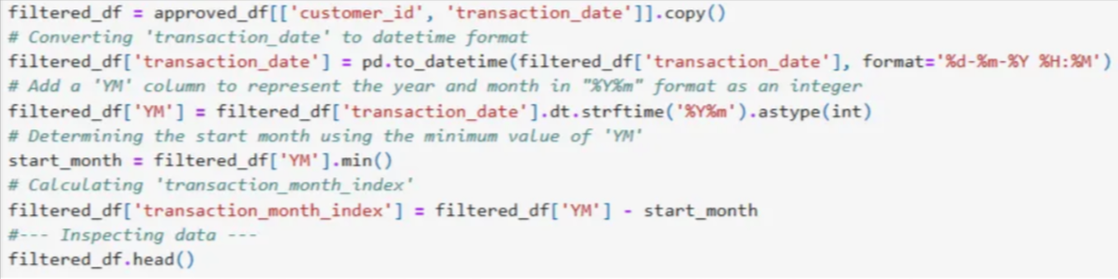
Technical Details:
Data Cleaning & Preprocessing:
The dataset required thorough cleaning and preprocessing to ensure accurate analysis. The main steps included:
Handling missing values: This step ensured that missing values were either imputed or removed.

Slide 7
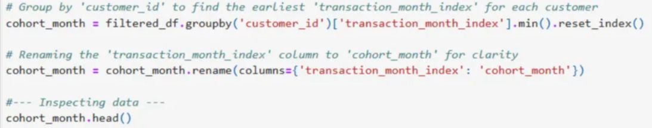
Date formatting: In this step, I converted the transaction_date column to a consistent datetime format.

Slide 8
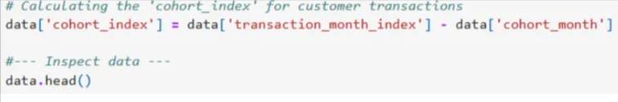
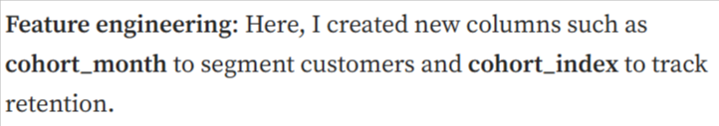
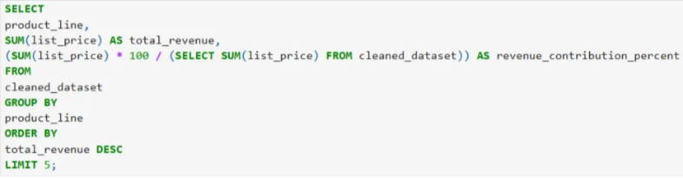

Slide 9
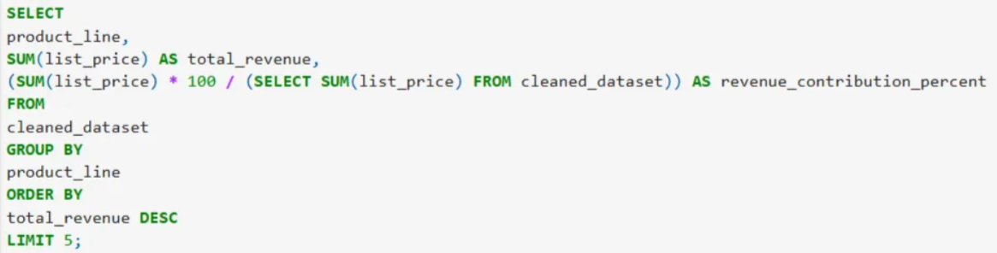
Aggregation: I grouped data by customer and transaction attributes to calculate metrics like average profit and total revenue.

Slide 10
SQL Queries for Analysis:
The central part of this project relied on writing complex SQL queries to extract and analyze relevant insights. Some of the queries that I used included:
- Cohort analysis to track customer behavior by first purchase month.
- Calculating the total sales for each brand and product line.
- Filtering and aggregating transactions by customer to understand their overall spending.
Cohort Calculation:
I calculated cohort indices by subtracting the cohort_month from each customer’s transaction_month_index, and it allowed for a time-based comparison of customer behaviors across cohorts.

Slide 11
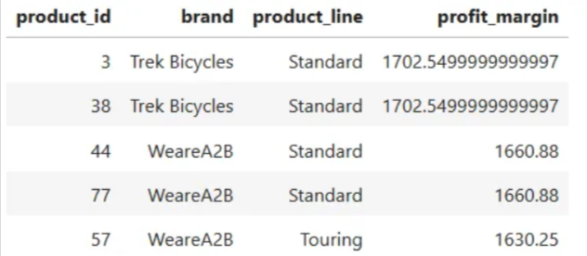
Key Design Decisions and Their Rationale:
Cohort-Based Analysis:
Cohort analysis was chosen to track customers over time and to assess the effectiveness of retention strategies. This segmentation provides actionable insights into how customers engage with the business and whether they will continue making purchases after their first transaction.
SQL for Data Manipulation:
SQL was used for data extraction and aggregation due to its efficiency in handling large datasets. The use of window functions and grouping allowed me for precise calculations and better handling of the data’s complexities.

Slide 12
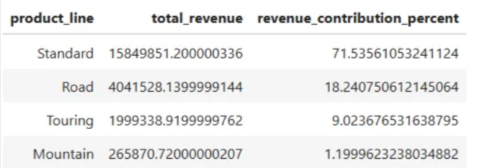
Profit Margin Focus:
The analysis focused on identifying products with high profit margins. This is an important aspect for businesses looking to optimize their product offering and pricing strategies.

Slide 13
Revenue Contribution:
I also calculated the revenue contribution percentage for product lines, and it helped me to highlight the most profitable product categories. This insight is important for making data-driven decisions regarding inventory management and marketing investments.
My Role and Contributions:
In this project, I was responsible for the entire data analysis pipeline, which included:
Data collection and cleaning: I ensured that the dataset was clean and ready for analysis.
SQL query development: I wrote complex SQL queries to extract key insights, such as cohort behavior, customer spending patterns, and product performance.
Cohort analysis implementation: I implemented the cohort analysis to track customer retention and analyze transaction behavior.
Data visualization: I created various visualizations to present the results effectively.

Slide 14
Profit Margin Focus:
The analysis focused on identifying products with high profit margins. This is an important aspect for businesses looking to optimize their product offering and pricing strategies.
Reporting:
I collected the findings into actionable insights for the business stakeholders.
Technical Challenges and Solutions:
Handling Missing Data:
Challenge: The dataset contained some missing values which could affect the accuracy of the analysis.
Solution: I applied data imputation methods where necessary and removed rows with excessive missing data to ensure clean results.

Slide 15
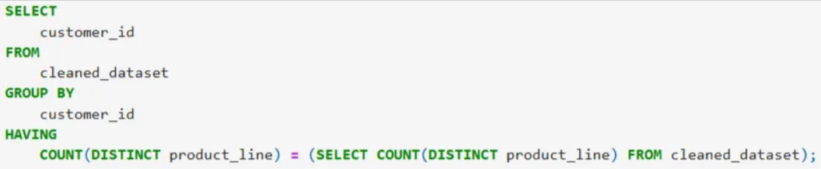
Data Aggregation:
Challenge: Aggregating the data by various customer and product attributes required careful handling of time-series data and cohort-based indices.
Solution: I designed efficient aggregation steps and used group by and having clauses to ensure that the final dataset was accurate and meaningful.

Slide 16
Complex SQL Queries:
Challenge: Writing SQL queries for cohort analysis and aggregating large datasets was complex.
Solution: I divided the queries into smaller subqueries and used window functions and joins effectively to get the necessary results.

Slide 17
Results and Impact:
The cohort analysis provided valuable insights into customer behavior, and highlighted retention rates and purchasing patterns across different product lines.
By identifying the top-performing products and analyzing their revenue contributions, the business was able to:
Optimize inventory and marketing strategies for the most profitable product lines.
Understand customer purchasing behaviors, which led to more personalized marketing efforts.
Make data-driven decisions to enhance customer retention.

Slide 18
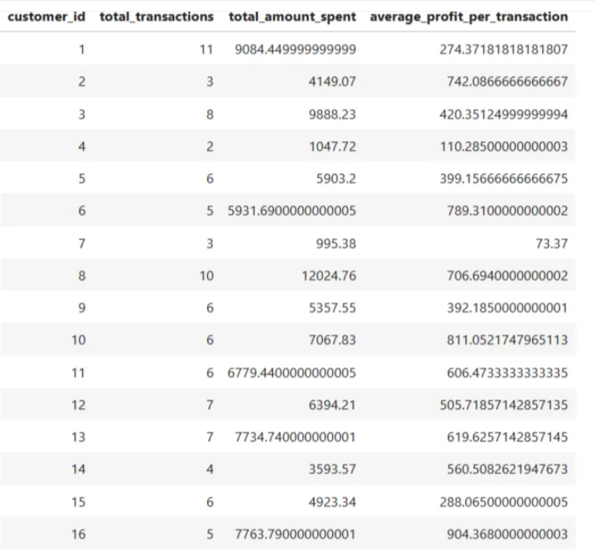

Slide 19
Key Outcomes:
Increased customer retention: By understanding cohort behavior, the company could customize marketing efforts to improve retention.
Optimized product offerings: Through the analysis, I identified which products offered the highest profit margins, and it leads to better product positioning.
Revenue growth: The revenue contribution analysis helped allocate resources towards the most profitable product lines, and it directly impacted sales.

Slide 20
Further Improvements:
Adding Machine Learning:
Machine learning models can be used to predict future purchasing behaviors, enabling proactive retention strategies.
Real-Time Analytics:
We can implement real-time cohort analysis that would allow the business to track customer behavior and adjust marketing efforts instantly.
Deep Diving into Customer Segmentation:
By applying more granular segmentation methods, such as clustering, the business can gain deeper insights into customer preferences.
Advanced Visualizations:
We can use advanced visualization tools like Tableau or Power BI that could improve data presentation and enable easier interaction with the results.

